Slide 1
Data Base Management System Unit -2

Slide 2
Relational Model
Main idea:
Table: relation
Column header: attribute
Row: tuple
Relational schema: name(attributes)
Example: employee(ssno,name,salary)
Attributes:
Each attribute has a domain – domain constraint
Each attribute is atomic: we cannot refer to or directly see a subpart of the value.

Slide 3
Components of Relational Model
There are three components:
A set of domains and a set of relations
Integrity rules
Operations on relations
Characteristics of Relations
1. Ordering of Tuple in Relation
Ordering of values within a Tuple
Values in Tuples : Atomic and NULL values
Interpretation of a Relation

Slide 4
Relation Example
Account
Customer
Database schema consists of
a set of relation schema
Account(AccountId, CustomerId, Balance)
Customer(Id, Name, Addr)
a set of constraints over the relation schema
AccountId, CustomerId must be integers
Name and Addr must be string of characters
CustomerId in Account must be from Ids in Customer

Slide 5
NULL value
Customer(Id, Name, Addr)
Attributes can take a special value: NULL
Either not known: we don’t know Jack’s address
or does not exist: savings account 1001 does not have “overdraft”
This is the single-value constrain on Attr: at most one
Either one: a string
Or zero: NULL

Slide 6
Why Constraints?
Make tasks of application programmers easier:
If DBMS guarantees account >=0, then debit application programmers do not worry about overdrawn accounts.
Enable us to identify redundancy in schemas:
Help in database design
E.g., if we know course names are unique, then we may not need another “course id” attribute
Help the DBMS in query processing.
They can help the query optimizer choose a good execution plan

Slide 7
Domain Constraints
Every attribute has a type:
integer, float, date, boolean, string, etc.
An attribute can have a domain. E.g.:
Id > 0
Salary > 0
age < 100
City in {Irvine, LA, Riverside}
An insertion can violate the domain constraint.
DBMS checks if insertion violates domain constraint and reject the insertion.
Integer
String
String
violations

Slide 8
Key Constraints
Superkey: a set of attributes such that if two tuples agree on these attributes, they must agree on all the attributes
All attributes always form a superkey.
Example:
AccountID forms a superkey, I.e., if two records agree on this attribute, then they must agree on other attributes
Notice that the relational model allow duplicates
Any superset of {Account} is also a superkey
There can be multiple superkeys
Log: assume LogID is a superkey
Log(LogId, AccountId, Xact#, Time, Amount)
Illegal

Slide 9
Keys
Key:
Minimal superkey (no proper subset is a superkey)
If more than one key: choose one as a primary key
Example:
Key 1: LogID (primary key)
Key 2: AccountId, Xact#
Superkeys: all supersets of the keys
Log(LogId, AccountId, Xact#, Time, Ammount)
OK

Slide 10
Integrity Rules
There are two Integrity Rules that every relation should follow :
Entity Integrity (Rule 1)
Referential Integrity (Rule 2)
Entity Integrity states that –
If attribute A of a relation R is a prime attribute of R, then A can not accept null and duplicate values.

Slide 11
Referential Integrity Constraints
Given two relations R and S, R has a primary key X (a set of attributes)
A set of attributes Y is a foreign key of S if:
Attributes in Y have same domains as attributes X
For every tuple s in S, there exists a tuple r in R: s[Y] = r[X].
A referential integrity constraint from attributes Y of S to R means that Y is a foreign key that refers to the primary key of R.
The foreign key must be either equal to the primary key or be entirely null.
Foreign key
Y
X (primary key of R)
r
s
S
R

Slide 12
Examples of Referential Integrity
Account
Customer
Account.customerId to Customer.Id
Student
Dept
Student.dept to Dept.name: every value of Student.dept must also be a value of Dept.name.

Slide 13
Relational Algebra
Relational Algebra is :
The formal description of how a relational database operates
An interface to the data stored in the database itself.
The mathematics which underpin SQL operations
The DBMS must take whatever SQL statements the user types in and translate them into relational algebra operations before applying them to the database.

Slide 14
Operators - Retrieval
There are two groups of operations:
Mathematical set theory based operations: UNION, INTERSECTION, DIFFERENCE, and CARTESIAN PRODUCT.
Special database oriented operations: SELECT , PROJECT and JOIN.

Slide 15
Symbolic Notation
SELECT σ (sigma)
PROJECT π (pi)
PRODUCT × (times)
JOIN ⋈ (bow-tie)
UNION ∪ (cup)
INTERSECTION ∩ (cap)
DIFFERENCE - (minus)
RENAME ρ (rho)

Slide 16
SET Operations - requirements
For set operations to function correctly the relations R and S must be union compatible. Two relations are union compatible if
They have the same number of attributes
The domain of each attribute in column order is the same in both R and S.

Slide 17
Set Operations - semantics
Consider two relations R and S.
UNION of R and S the union of two relations is a relation that includes all the tuples that are either in R or in S or in both R and S. Duplicate tuples are eliminated.
INTERSECTION of R and S the intersection of R and S is a relation that includes all tuples that are both in R and S.
DIFFERENCE of R and S the difference of R and S is the relation that contains all the tuples that are in R but that are not in S.

Slide 18
Union ∪, Intersection ∩, Difference -
Set operators. Relations must have the same schema.
R(name, dept)
S(name, dept)
R∪S
R ∩ S
R-S

Slide 19
Relational SELECT
SELECT is used to obtain a subset of the tuples of a relation that satisfy a select condition.
For example, find all employees born after 1st Jan 1950:
SELECT _{dob > ’01/JAN/1950’} (employee)
or
σ _{dob > ’01/JAN/1950’} (employee)
Conditions can be combined together using ^ (AND) and v (OR). For example, all employees in department 1 called `Smith':
σ depno = 1 ^ surname = `Smith‘ (employee)

Slide 20
Selection σ
σ _{c} (R): return tuples in R that satisfy condition C.
Emp (name, dept, salary)
σ _{salary>35K} (Emp)
σ _{dept=ics and salary<40K} (Emp)

Slide 21
Relational PROJECT
The PROJECT operation is used to select a subset of the attributes of a relation by specifying the names of the required attributes.
For example, to get a list of all employees with their salary
PROJECT _{ename, salary} (employee)
OR
π_{ename, salary}(employee)

Slide 22
Projection Π
Π_{A1,…,Ak}(R): pick columns of attributes A1,…,Ak of R.
Emp (name, dept, salary)
Π_{name,dept} (Emp)
Π_{name} (Emp)
Duplicates (“Jack”) eliminated.

Slide 23
CARTESIAN PRODUCT
The Cartesian Product is also an operator which works on two sets. It is sometimes called the CROSS PRODUCT or CROSS JOIN.
It combines the tuples of one relation with all the tuples of the other relation.

Slide 24
Cartesian Product: ×
R × S: pair each tuple r in R with each tuple s in S.
Emp (name, dept)
Contact(name, addr)
Emp × Contact

Slide 25
JOIN Example
JOIN Operator
JOIN is used to combine related tuples from two relations R and S.
In its simplest form the JOIN operator is just the cross product of the two relations and is represented as (R ⋈ S).
JOIN allows you to evaluate a join condition between the attributes of the relations on which the join is undertaken.
The notation used is
R ⋈ S
Join Condition

Slide 26
Join
R S = σ _{c} (R × S)
C
Join condition C is of the form:
<cond_1> AND <cond_2> AND … AND <cond_k>
Each cond_i is of the form A op B, where:
A is an attribute of R, B is an attribute of S
op is a comparison operator: =, <, >, ≥, ≤, or ≠.
Different types:
Theta-join
Equi-join
Natural join

Slide 27
Theta-Join
R S
R.A>S.C
R(A,B)
S(C,D)
R × S
Result

Slide 28
Theta-Join
R S
R.A>S.C, R.B ≠ S.D
R(A,B)
S(C,D)
Result
R × S

Slide 29
Equi-Join
Special kind of theta-join: C only uses the equality operator.
R(A,B)
S(C,D)
R S
R × S
R.B=S.D
Result

Slide 30
Natural-Join
Relations R and S. Let L be the union of their attributes.
Let A1,…,Ak be their common attributes.
R S = Π _{L} (R S)
R.A1=S.A1,…,R.Ak=S.Ak

Slide 31
Natural-Join
Emp (name, dept)
Contact(name, addr)
Emp Contact: all employee names, depts, and addresses.
Emp × Contact
Result

Slide 32
Outer Joins
Motivation: “join” can lose information
E.g.: natural join of R and S loses info about Mary, since the tuple does not join with other tuples.
Called “dangling tuples”.
R
S
Outer join: natural join, but use NULL values to fill in dangling tuples.
Three types: “left”, “right”, or “full”

Slide 33
Left Outer Join
R
S
Left outer join
R S
Pad null value for left dangling tuples.

Slide 34
Right Outer Join
R
S
Right outer join
R S
Pad null value for right dangling tuples.

Slide 35
Full Outer Join
R
S
Full outer join
R S
Pad null values for both left and right dangling tuples.

Slide 36
OUTER JOIN Example 1

Slide 37
OUTER JOIN Example 2

Slide 38
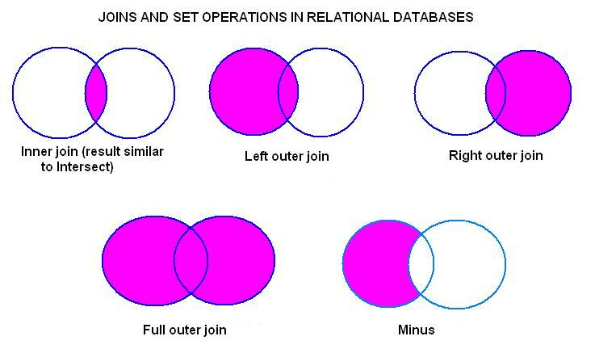
Joins Revised
Joins may be represented as
Venn diagrams, as shown
above along with other common
set operations:
Result of applying these joins in a query: INNER JOIN: Select only those rows that have values in common in the columns specified in the ON clause.
LEFT, RIGHT, or FULL OUTER JOIN: Select all rows from the table on the left (or right, or both) regardless of whether the other table has values in common and (usually) enter NULL where data is missing.

Slide 39
Combining Different Operations
Construct general expressions using basic operations.
Schema of each operation:
∪, ∩, -: same as the schema of the two relations
Selection σ : same as the relation’s schema
Projection Π: attributes in the projection
Cartesian product × : attributes in two relations, use prefix to avoid confusion
Theta Join : same as ×
Natural Join : union of relations’ attributes, merge common attributes
Renaming: new renamed attributes
C

Slide 40
Example 1
customer(ssn, name, city)
account(custssn, balance)
“List account balances of Tom.”
Π_{balance}
Tree representation
×
σ _{name=tom}
account
customer

Slide 41
Example 1(cont)
customer(ssn, name, city)
account(custssn, balance)
“List account balances of Tom.”
Π_{balance}
ssn=custssn
σ _{name=tom}
account
customer

Slide 42
Division Operator
Not supported as a primitive operator, but useful for expressing queries like:
“Find sailors who have reserved all boats.”
Let A have 2 fields, x and y; B have only field y:
A/B contains all x tuples (sailors) such that for every y tuple (boat) in B, there is an xy tuple in A Or : If the set of y values (boats) associated with an x value (sailor) in A contains all y values in B, the x value is in A/B.
In general, x and y can be any lists of fields; y is the list of fields in B , and xy is the list of fields of A

Slide 43
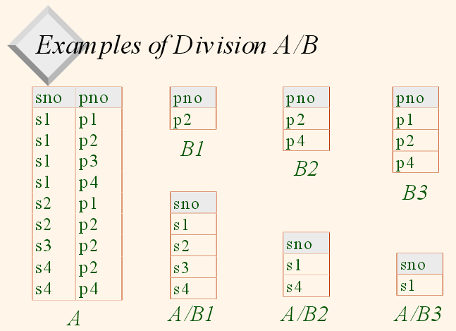
Division Example

Slide 44
Example 1
STUDENT(Sno, Name, Major, Ddate)
COURSE(Cno, cname, Dept)
ENROLL(Sno, Cno, quarter, BISBN)
TEXT(BISBN, title, Publisher, Author)
List the names of courses taken by at least one student with quarter =‘w99’
List any department that has all its books published by ‘BPB’

Slide 45
Example 1 cont…
SQL Solution:
SELECT dept FROM Course
WHERE cno IN (
(SELECT E.cno FROM Enroll E, Text T
WHERE E.BISBN = T.BISBN
AND T.Publisher = ‘BPB’)
MINUS
(SELECT E.cno FROM Enroll E, Text T
WHERE E.BISBN = T.BISBN
AND T.Publisher <>‘BPB’)
)

Slide 46
Example 2
EMPLOYEE(eno, name, age, dno, salary)
WORK_ON(pno, eno)
PROJECT(pno, pname, location)
Display the names of projects at “Delhi”
Find the project name of employee whose salary is greater than 10000.
Retrieve the name and eno of employee working on pno =100.

Slide 47
Example 3
SUPPLIER(sid, sname, saddr)
PARTS(pid, pname, color)
CATALOG(sid, pid, cost)
Find the name of all suppliers who supply yellow parts.
Find the name of suppliers who supply both blue and black parts.
Find supplier ids who supply all parts.
Find supplier ids who do not supply red parts.

Slide 48
Example 3 cont..
SQL Solution (2):
SELECT sname FROM Supplier S, Catalog C
WHERE S. sid = C.sid AND C.sid =
(SELECT C.sid FROM Catalog C, Part P WHERE C.pid=P.pid and P.color= ‘Blue’)
INTERSECT
SELECT sname FROM Supplier S, Catalog C
WHERE S. sid = C.sid AND C.sid =
(SELECT C.sid FROM Catalog C, Part P WHERE C.pid=P.pid and P.color= ‘Black’)

Slide 49
Example 3 cont..
SQL Solution (3):
SELECT sid FROM Catalog GROUP BY sid
HAVING count(*) = (SELECT count(pid) FROM Parts)
SQL Solution (4):
SELECT sid FROM Catalog C, Parts P
WHERE C.pid = P.id
AND P.color<>’Red’

Slide 50
Comparing RA and SQL
Relational algebra:
is closed (the result of every expression is a relation)
has a rigorous foundation
has simple semantics
is used for reasoning, query optimisation, etc.
SQL:
is a superset of relational algebra
has convenient formatting features, etc.
provides aggregate functions
has complicated semantics
is an end-user language.

Slide 51
Introduction to SQL

Slide 52
Outline
Overview of The SQL Query Language
Data Definition
Basic Query Structure
Additional Basic Operations
Set Operations
Null Values
Aggregate Functions
Nested Subqueries
Modification of the Database

Slide 53
History
IBM Sequel language developed as part of System R project at the IBM San Jose Research Laboratory
Renamed Structured Query Language (SQL)
ANSI and ISO standard SQL:
SQL-86
SQL-89
SQL-92
SQL:1999 (language name became Y2K compliant!)
SQL:2003
Commercial systems offer most, if not all, SQL-92 features, plus varying feature sets from later standards and special proprietary features.
Not all examples here may work on your particular system.

Slide 54
Data Definition Language
The SQL data-definition language (DDL) allows the specification of information about relations, including:
The schema for each relation.
The domain of values associated with each attribute.
Integrity constraints
And as we will see later, also other information such as
The set of indices to be maintained for each relations.
Security and authorization information for each relation.
The physical storage structure of each relation on disk.

Slide 55
Domain Types in SQL
Data Type Syntax | Oracle 9i | Oracle 10g | Oracle 11g | Explanation
char(size) | Maximum size of 2000 bytes. | Maximum size of 2000 bytes. | Maximum size of 2000 bytes. | Where size is the number of characters to store. Fixed-length strings. Space padded.
varchar2(size) | Maximum size of 4000 bytes. Maximum size of 32KB in PLSQL. | Maximum size of 4000 bytes. Maximum size of 32KB in PLSQL. | Maximum size of 4000 bytes. Maximum size of 32KB in PLSQL. | Where size is the number of characters to store. Variable-length string.
long | Maximum size of 2GB. | Maximum size of 2GB. | Maximum size of 2GB. | Variable-length strings. (backward compatible)
raw | Maximum size of 2000 bytes. | Maximum size of 2000 bytes. | Maximum size of 2000 bytes. | Variable-length binary strings
long raw | Maximum size of 2GB. | Maximum size of 2GB. | Maximum size of 2GB. | Variable-length binary strings. (backward compatible)
number(p,s) | Precision can range from 1 to 38. Scale can range from -84 to 127. | Precision can range from 1 to 38. Scale can range from -84 to 127. | Precision can range from 1 to 38. Scale can range from -84 to 127. | Where p is the precision and s is the scale.
date | A date between Jan 1, 4712 BC and Dec 31, 9999 AD. | A date between Jan 1, 4712 BC and Dec 31, 9999 AD. | A date between Jan 1, 4712 BC and Dec 31, 9999 AD.

Slide 56
Create Table Construct
An SQL relation is defined using the create table command:
create table r (A₁ D₁, A₂ D₂, ..., A_{n} D_{n}, (integrity-constraint₁), ..., (integrity-constraint_{k}))
r is the name of the relation
each A_{i} is an attribute name in the schema of relation r
D_{i} is the data type of values in the domain of attribute A_{i}
Example:
create table instructor ( ID char(5), name varchar(20), dept_name varchar(20), salary numeric(8,2))

Slide 57
Integrity Constraints in Create Table
not null
primary key (A₁, ..., A_{n} )
foreign key (A_{m}, ..., A_{n} ) references r
Example:
create table instructor ( ID char(5), name varchar(20) not null, dept_name varchar(20), salary numeric(8,2), primary key (ID), foreign key (dept_name) references department);
primary key declaration on an attribute automatically ensures not null

Slide 58
And a Few More Relation Definitions
create table student ( ID varchar(5), name varchar(20) not null, dept_name varchar(20), tot_cred numeric(3,0), primary key (ID),
foreign key (dept_name) references department);
create table takes ( ID varchar(5), course_id varchar(8), sec_id varchar(8), semester varchar(6), year numeric(4,0), grade varchar(2),
primary key (ID, course_id, sec_id, semester, year) ,
foreign key (ID) references student, foreign key (course_id, sec_id, semester, year) references section);
Note: sec_id can be dropped from primary key above, to ensure a student cannot be registered for two sections of the same course in the same semester

Slide 59
And more still
create table course ( course_id varchar(8), title varchar(50), dept_name varchar(20), credits numeric(2,0),
primary key (course_id),
foreign key (dept_name) references department);

Slide 60
Updates to tables
Insert
insert into instructor values (‘10211’, ’Smith’, ’Biology’, 66000);
Delete
Remove all tuples from the student relation
delete from student
Drop Table
drop table r
Alter
alter table r add A D
where A is the name of the attribute to be added to relation r and D is the domain of A.
All exiting tuples in the relation are assigned null as the value for the new attribute.
alter table r drop A
where A is the name of an attribute of relation r
Dropping of attributes not supported by many databases.

Slide 61
Basic Query Structure
A typical SQL query has the form: select A₁, A₂, ..., A_{n} from r₁, r₂, ..., r_{m} where P
A_{i} represents an attribute
R_{i} represents a relation
P is a predicate.
The result of an SQL query is a relation.

Slide 62
The select Clause
The select clause lists the attributes desired in the result of a query
corresponds to the projection operation of the relational algebra
Example: find the names of all instructors: select name from instructor
NOTE: SQL names are case insensitive (i.e., you may use upper- or lower-case letters.)
E.g., Name ≡ NAME ≡ name
Some people use upper case wherever we use bold font.
Notes:
3

Slide 63
The select Clause (Cont.)
SQL allows duplicates in relations as well as in query results.
To force the elimination of duplicates, insert the keyword distinct after select.
Find the department names of all instructors, and remove duplicates
select distinct dept_name from instructor
The keyword all specifies that duplicates should not be removed.
select all dept_name from instructor
Notes:
4

Slide 64
The select Clause (Cont.)
An asterisk in the select clause denotes “all attributes”
select * from instructor
An attribute can be a literal with no from clause
select ‘437’
Results is a table with one column and a single row with value “437”
Can give the column a name using:
select ‘437’ as FOO
An attribute can be a literal with from clause
select ‘A’ from instructor
Result is a table with one column and N rows (number of tuples in the instructors table), each row with value “A”
Notes:
5

Slide 65
The select Clause (Cont.)
The select clause can contain arithmetic expressions involving the operation, +, –, ∗, and /, and operating on constants or attributes of tuples.
The query:
select ID, name, salary/12 from instructor
would return a relation that is the same as the instructor relation, except that the value of the attribute salary is divided by 12.
Can rename “salary/12” using the as clause:
select ID, name, salary/12 as monthly_salary
Notes:
5

Slide 66
The where Clause
The where clause specifies conditions that the result must satisfy
Corresponds to the selection predicate of the relational algebra.
To find all instructors in Comp. Sci. dept
select name from instructor where dept_name = ‘Comp. Sci.'
Comparison results can be combined using the logical connectives and, or, and not
To find all instructors in Comp. Sci. dept with salary > 80000
select name from instructor where dept_name = ‘Comp. Sci.' and salary > 80000
Comparisons can be applied to results of arithmetic expressions.
Notes:
6

Slide 67
The from Clause
The from clause lists the relations involved in the query
Corresponds to the Cartesian product operation of the relational algebra.
Find the Cartesian product instructor X teaches
select ∗ from instructor, teaches
generates every possible instructor – teaches pair, with all attributes from both relations.
For common attributes (e.g., ID), the attributes in the resulting table are renamed using the relation name (e.g., instructor.ID)
Cartesian product not very useful directly, but useful combined with where-clause condition (selection operation in relational algebra).
Notes:
8

Slide 68
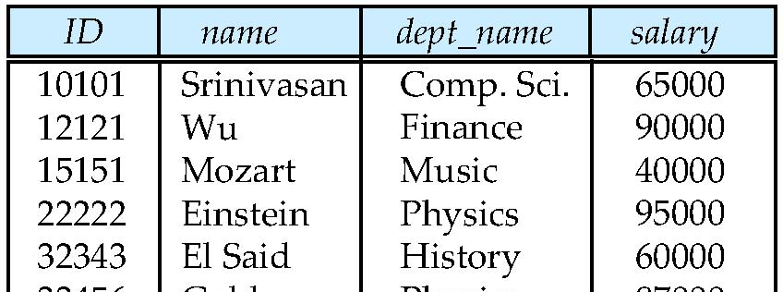
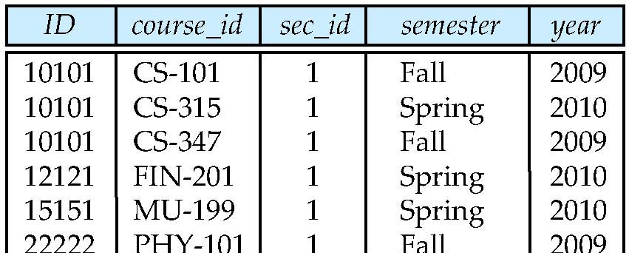
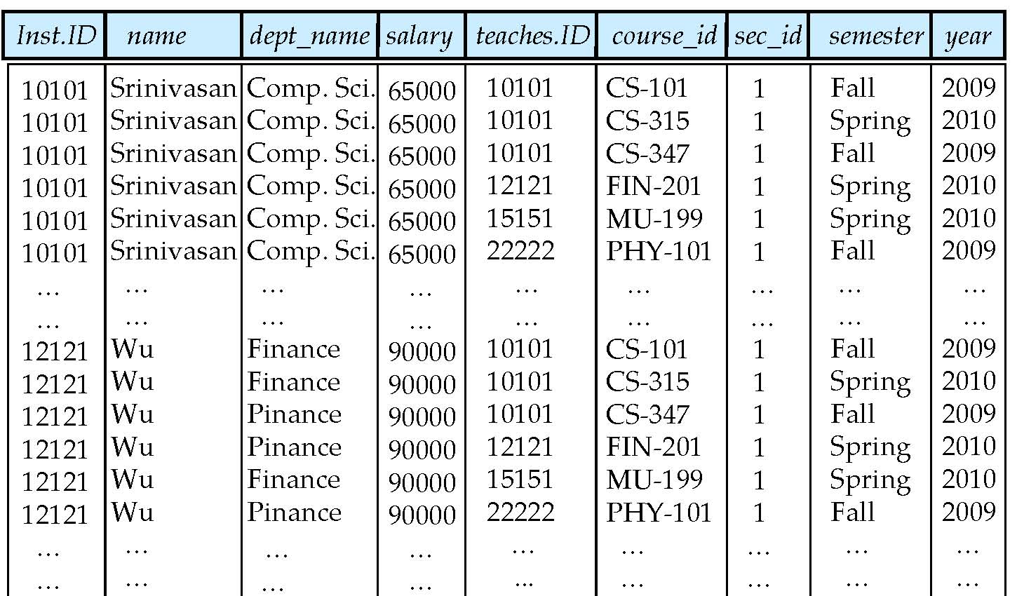
Cartesian Product
instructor
teaches

Slide 69
Examples
Find the names of all instructors who have taught some course and the course_id
select name, course_id from instructor , teaches where instructor.ID = teaches.ID
Find the names of all instructors in the Art department who have taught some course and the course_id
select name, course_id from instructor , teaches where instructor.ID = teaches.ID and instructor. dept_name = ‘Art’
Notes:
9

Slide 70
The Rename Operation
The SQL allows renaming relations and attributes using the as clause:
old-name as new-name
Find the names of all instructors who have a higher salary than some instructor in ‘Comp. Sci’.
select distinct T.name from instructor as T, instructor as S where T.salary > S.salary and S.dept_name = ‘Comp. Sci.’
Keyword as is optional and may be omitted instructor as T ≡ instructor T
Notes:
9

Slide 71
Self Join Example
Relation emp-super
person supervisor
Bob Alice
Mary Susan
Alice David
David Mary
Find the supervisor of “Bob”
Find the supervisor of the supervisor of “Bob”
Find ALL the supervisors (direct and indirect) of “Bob

Slide 72
String Operations
SQL includes a string-matching operator for comparisons on character strings. The operator like uses patterns that are described using two special characters:
percent ( % ). The % character matches any substring.
underscore ( _ ). The _ character matches any character.
Find the names of all instructors whose name includes the substring “dar”.
select name from instructor where name like '%dar%'
Match the string “100%”
like ‘100 \%' escape '\'
in that above we use backslash (\) as the escape character.

Slide 73
String Operations (Cont.)
Patterns are case sensitive.
Pattern matching examples:
‘Intro%’ matches any string beginning with “Intro”.
‘%Comp%’ matches any string containing “Comp” as a substring.
‘_ _ _’ matches any string of exactly three characters.
‘_ _ _ %’ matches any string of at least three characters.
SQL supports a variety of string operations such as
concatenation (using “||”)
converting from upper to lower case (and vice versa)
finding string length, extracting substrings, etc.

Slide 74
Ordering the Display of Tuples
List in alphabetic order the names of all instructors
select distinct name from instructor order by name
We may specify desc for descending order or asc for ascending order, for each attribute; ascending order is the default.
Example: order by name desc
Can sort on multiple attributes
Example: order by dept_name, name

Slide 75
Where Clause Predicates
SQL includes a between comparison operator
Example: Find the names of all instructors with salary between $90,000 and $100,000 (that is, ≥ $90,000 and ≤ $100,000)
select name from instructor where salary between 90000 and 100000
Tuple comparison
select name, course_id from instructor, teaches where (instructor.ID, dept_name) = (teaches.ID, ’Biology’);
Notes:
7

Slide 76
Set Operations
Find courses that ran in Fall 2009 or in Spring 2010
(select course_id from section where sem = ‘Fall’ and year = 2009) union (select course_id from section where sem = ‘Spring’ and year = 2010)
Find courses that ran in Fall 2009 and in Spring 2010
(select course_id from section where sem = ‘Fall’ and year = 2009) intersect (select course_id from section where sem = ‘Spring’ and year = 2010)
Find courses that ran in Fall 2009 but not in Spring 2010
(select course_id from section where sem = ‘Fall’ and year = 2009) except (select course_id from section where sem = ‘Spring’ and year = 2010)

Slide 77
Set Operations (Cont.)
Find the salaries of all instructors that are less than the largest salary.
select distinct T.salary from instructor as T, instructor as S where T.salary < S.salary
Find all the salaries of all instructors
select distinct salary from instructor
Find the largest salary of all instructors.
(select “second query” ) except (select “first query”)
Notes:
9

Slide 78
Set Operations (Cont.)
Set operations union, intersect, and except
Each of the above operations automatically eliminates duplicates
To retain all duplicates use the corresponding multiset versions union all, intersect all and except all.
Suppose a tuple occurs m times in r and n times in s, then, it occurs:
m + n times in r union all s
min(m,n) times in r intersect all s
max(0, m – n) times in r except all s

Slide 79
Null Values
It is possible for tuples to have a null value, denoted by null, for some of their attributes
null signifies an unknown value or that a value does not exist.
The result of any arithmetic expression involving null is null
Example: 5 + null returns null
The predicate is null can be used to check for null values.
Example: Find all instructors whose salary is null.
select name from instructor where salary is null

Slide 80
Aggregate Functions
These functions operate on the multiset of values of a column of a relation, and return a value
avg: average value min: minimum value max: maximum value sum: sum of values count: number of values

Slide 81
Aggregate Functions (Cont.)
Find the average salary of instructors in the Computer Science department
select avg (salary) from instructor where dept_name= ’Comp. Sci.’;
Find the total number of instructors who teach a course in the Spring 2010 semester
select count (distinct ID) from teaches where semester = ’Spring’ and year = 2010;
Find the number of tuples in the course relation
select count (*) from course;

Slide 82
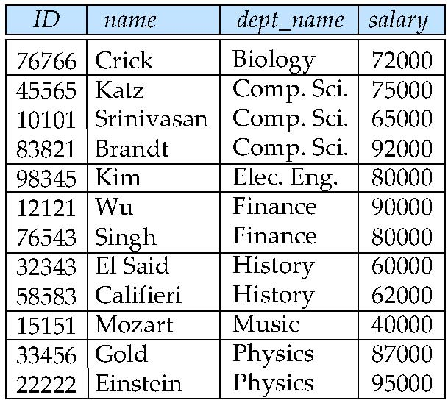
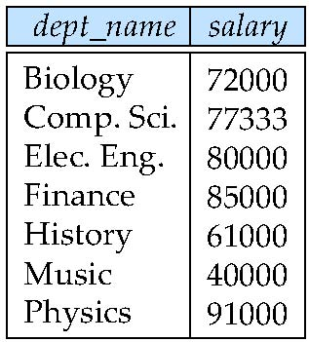
Aggregate Functions – Group By
Find the average salary of instructors in each department
select dept_name, avg (salary) as avg_salary from instructor group by dept_name;
avg_salary

Slide 83
Aggregation (Cont.)
Attributes in select clause outside of aggregate functions must appear in group by list
/* erroneous query */ select dept_name, ID, avg (salary) from instructor group by dept_name;

Slide 84
Aggregate Functions – Having Clause
Find the names and average salaries of all departments whose average salary is greater than 42000
select dept_name, avg (salary)
from instructor
group by dept_name
having avg (salary) > 42000;
Note: predicates in the having clause are applied after the formation of groups whereas predicates in the where clause are applied before forming groups

Slide 85
Null Values and Aggregates
Total all salaries
select sum (salary ) from instructor
Above statement ignores null amounts
Result is null if there is no non-null amount
All aggregate operations except count(*) ignore tuples with null values on the aggregated attributes
What if collection has only null values?
count returns 0
all other aggregates return null

Slide 86
Nested Subqueries
SQL provides a mechanism for the nesting of subqueries. A subquery is a select-from-where expression that is nested within another query.
The nesting can be done in the following SQL query select A₁, A₂, ..., A_{n} from r₁, r₂, ..., r_{m} where P
as follows:
A_{i} can be replaced be a subquery that generates a single value.
r_{i} can be replaced by any valid subquery
P can be replaced with an expression of the form:
B <operation> (subquery)
Where B is an attribute and <operation> to be defined later.

Slide 87
Subqueries in the Where Clause

Slide 88
Subqueries in the Where Clause
A common use of subqueries is to perform tests:
For set membership
For set comparisons
For set cardinality.

Slide 89
Set Membership
Find courses offered in Fall 2009 and in Spring 2010
select distinct course_id
from section
where semester = ’Fall’ and year= 2009 and course_id in (select course_id
from section
where semester = ’Spring’ and year= 2010);
Find courses offered in Fall 2009 but not in Spring 2010
select distinct course_id
from section
where semester = ’Fall’ and year= 2009 and course_id not in (select course_id
from section
where semester = ’Spring’ and year= 2010);

Slide 90
Set Membership (Cont.)
Find the total number of (distinct) students who have taken course sections taught by the instructor with ID 10101
select count (distinct ID)
from takes
where (course_id, sec_id, semester, year) in (select course_id, sec_id, semester, year
from teaches
where teaches.ID= 10101);
Note: Above query can be written in a much simpler manner. The formulation above is simply to illustrate SQL features.

Slide 91
Set Comparison – “some” Clause
Find names of instructors with salary greater than that of some (at least one) instructor in the Biology department.
select distinct T.name
from instructor as T, instructor as S
where T.salary > S.salary and S.dept name = ’Biology’;
Same query using > some clause
select name
from instructor
where salary > some (select salary
from instructor
where dept name = ’Biology’);

Slide 92
Set Comparison – “all” Clause
Find the names of all instructors whose salary is greater than the salary of all instructors in the Biology department.
select name
from instructor
where salary > all (select salary
from instructor
where dept name = ’Biology’);

Slide 93
Test for Empty Relations
The exists construct returns the value true if the argument subquery is nonempty.
exists r ⇔ r ≠ Ø
not exists r ⇔ r = Ø

Slide 94
Use of “exists” Clause
Yet another way of specifying the query “Find all courses taught in both the Fall 2009 semester and in the Spring 2010 semester”
select course_id from section as S where semester = ’Fall’ and year = 2009 and exists (select * from section as T where semester = ’Spring’ and year= 2010 and S.course_id = T.course_id);
Correlation name – variable S in the outer query
Correlated subquery – the inner query

Slide 95
Use of “not exists” Clause
Find all students who have taken all courses offered in the Biology department.
select distinct S.ID, S.name
from student as S
where not exists ( (select course_id
from course
where dept_name = ’Biology’)
except
(select T.course_id
from takes as T
where S.ID = T.ID));
First nested query lists all courses offered in Biology
Second nested query lists all courses a particular student took
Note that X – Y = Ø ⇔ X ⊆ Y
Note: Cannot write this query using = all and its variants

Slide 96
Test for Absence of Duplicate Tuples
The unique construct tests whether a subquery has any duplicate tuples in its result.
The unique construct evaluates to “true” if a given subquery contains no duplicates .
Find all courses that were offered at most once in 2009
select T.course_id from course as T where unique (select R.course_id from section as R where T.course_id= R.course_id and R.year = 2009);

Slide 97
Subqueries in the From Clause

Slide 98
Subqueries in the From Clause
SQL allows a subquery expression to be used in the from clause
Find the average instructors’ salaries of those departments where the average salary is greater than $42,000.”
select dept_name, avg_salary from (select dept_name, avg (salary) as avg_salary from instructor group by dept_name) where avg_salary > 42000;
Note that we do not need to use the having clause
Another way to write above query
select dept_name, avg_salary from (select dept_name, avg (salary) from instructor group by dept_name) as dept_avg (dept_name, avg_salary)
where avg_salary > 42000;

Slide 99
With Clause
The with clause provides a way of defining a temporary relation whose definition is available only to the query in which the with clause occurs.
Find all departments with the maximum budget with max_budget (value) as (select max(budget) from department) select department.name from department, max_budget where department.budget = max_budget.value;

Slide 100
Complex Queries using With Clause
Find all departments where the total salary is greater than the average of the total salary at all departments
with dept _total (dept_name, value) as
(select dept_name, sum(salary)
from instructor
group by dept_name),
dept_total_avg(value) as
(select avg(value)
from dept_total)
select dept_name
from dept_total, dept_total_avg
where dept_total.value > dept_total_avg.value;

Slide 101
Subqueries in the Select Clause

Slide 102
Scalar Subquery
Scalar subquery is one which is used where a single value is expected
List all departments along with the number of instructors in each department
select dept_name, (select count(*) from instructor where department.dept_name = instructor.dept_name) as num_instructors from department;
Runtime error if subquery returns more than one result tuple

Slide 103
Modification of the Database
Deletion of tuples from a given relation.
Insertion of new tuples into a given relation
Updating of values in some tuples in a given relation

Slide 104
Deletion
Delete all instructors
delete from instructor
Delete all instructors from the Finance department delete from instructor where dept_name= ’Finance’;
Delete all tuples in the instructor relation for those instructors associated with a department located in the Watson building.
delete from instructor where dept name in (select dept name from department where building = ’Watson’);

Slide 105
Deletion (Cont.)
Delete all instructors whose salary is less than the average salary of instructors
delete from instructor
where salary < (select avg (salary)
from instructor);
Problem: as we delete tuples from deposit, the average salary changes
Solution used in SQL:
1. First, compute avg (salary) and find all tuples to delete
2. Next, delete all tuples found above (without
recomputing avg or retesting the tuples)

Slide 106
Insertion
Add a new tuple to course
insert into course values (’CS-437’, ’Database Systems’, ’Comp. Sci.’, 4);
or equivalently
insert into course (course_id, title, dept_name, credits) values (’CS-437’, ’Database Systems’, ’Comp. Sci.’, 4);
Add a new tuple to student with tot_creds set to null
insert into student values (’3003’, ’Green’, ’Finance’, null);

Slide 107
Insertion (Cont.)
Add all instructors to the student relation with tot_creds set to 0
insert into student select ID, name, dept_name, 0 from instructor
The select from where statement is evaluated fully before any of its results are inserted into the relation.
Otherwise queries like
insert into table1 select * from table1
would cause problem

Slide 108
Updates
Increase salaries of instructors whose salary is over $100,000 by 3%, and all others by a 5%
Write two update statements:
update instructor set salary = salary * 1.03 where salary > 100000; update instructor set salary = salary * 1.05 where salary <= 100000;
The order is important
Can be done better using the case statement (next slide)

Slide 109
Case Statement for Conditional Updates
Same query as before but with case statement
update instructor set salary = case when salary <= 100000 then salary * 1.05 else salary * 1.03 end

Slide 110
Updates with Scalar Subqueries
Recompute and update tot_creds value for all students
update student S set tot_cred = (select sum(credits) from takes, course where takes.course_id = course.course_id and S.ID= takes.ID.and takes.grade <> ’F’ and takes.grade is not null);
Sets tot_creds to null for students who have not taken any course
Instead of sum(credits), use:
case when sum(credits) is not null then sum(credits) else 0 end

Slide 111
THANK YOU

